Slide 1



How to Perform a Trade-Off Analysis
Romain Fonteyne October 26th, 2023

Slide 2



STEP 1: FIGURES OF MERIT
The first step consists in defining the figures of merit related to your problem.
We can define a figure of merit (FOM) as a metric for comparing different alternatives or options.
Examples of FOM for dust cleaning systems:
Mass of the system/subsystem
Technological complexity
Types of surfaces the system can clean
Examples of FOM for lunar landing site selection:
Illimunation level
Telecommuncation windows
Risk of meteoroid impacts
WARNING: Each FOM should be independent from one another! They should not be linked, or they will become a bias for the trade-off analysis outcome.
How to Perform a Trade-Off Analysis

Slide 3
STEP 2: FIGURES OF MERIT PROPORTIONALITY
For each figure of merit, the following question should be asked:
If its value increases, is it a good thing or not?
If the answer is yes, then the proportionality is direct: the higher the value the better.
If the answer is no, then the proportionality is indirect: the higher the value the better.
Examples of directly proportional FOM for a lunar dust repelling:
Cleaning ratio: The higher the cleaning ratio the better the system will survive, thus it is positive for the project
Examples of indirectly proportional FOM for a lunar dust repelling:
Mass: The higher the mass the higher the cost of the mission, thus it is negative for the mission
How to Perform a Trade-Off Analysis

Slide 4
STEP 3: WEIGHING FIGURES OF MERIT
The next step is to give an intensity of importance to all the FOM.
Each FOM should be given a intensity of importance value between 1 and 9, where
1 = Equal importance (two activities contribute equally to the objective)
2 = Weak of slight importance
3 = Moderate importance
4 = Moderate plus importance
5 = Strong importance (experience and judgement strongly favor one activity over another)
6 = Strong plus importance
7 = Very strong (or demonstrated) importance
8 = Very, very strong importance
9 = Extreme importance (evidence favoring one activity over another is of the highest possible order)
How to Perform a Trade-Off Analysis

Slide 5
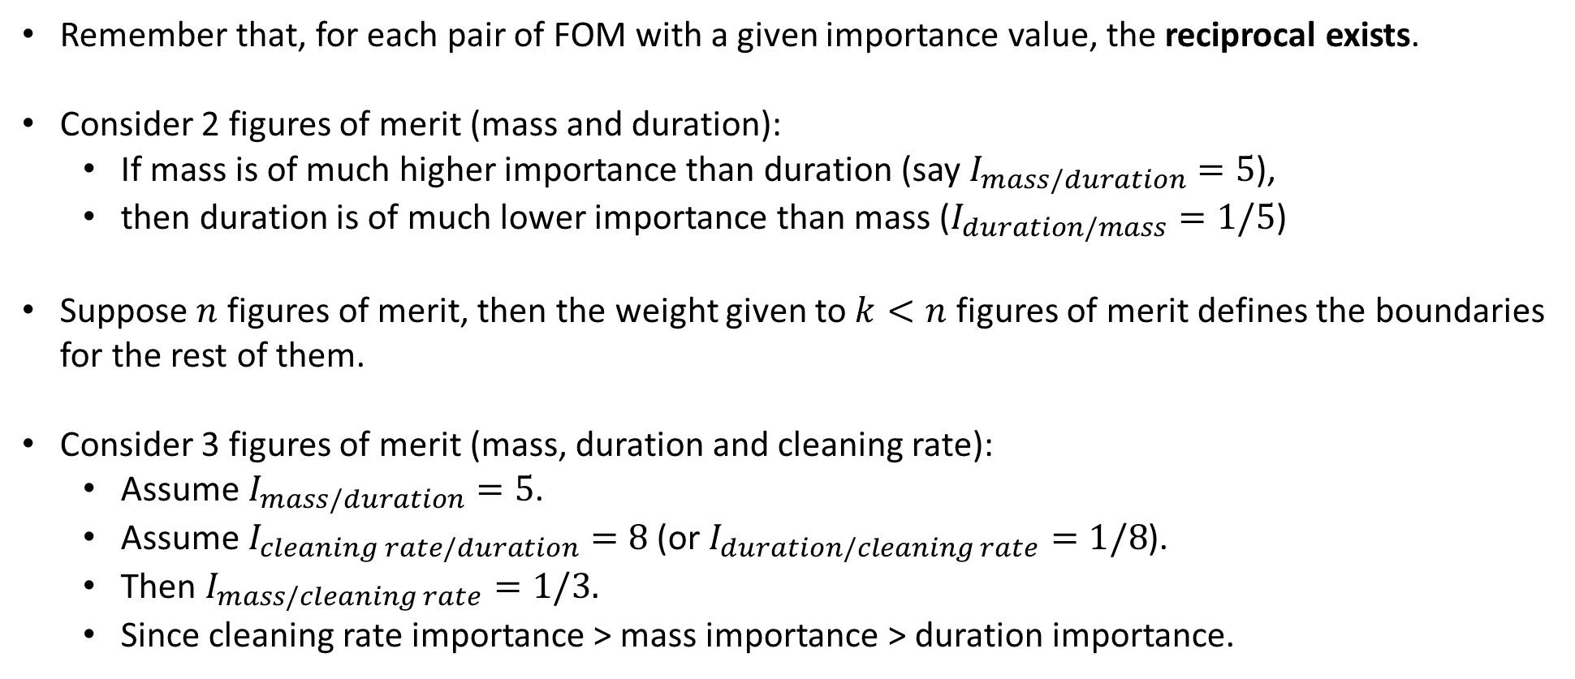
STEP 3: FOM PRIORITY MATRIX
Remember that, for each pair of FOM with a given importance value, the reciprocal exists.
Consider 2 figures of merit (mass and duration):
If mass is of much higher importance than duration (say $I_{mass/duration}=5$),
then duration is of much lower importance than mass ($I_{duration/mass}=1/5$)
Suppose $n$ figures of merit, then the weight given to $k<n$ figures of merit defines the boundaries for the rest of them.
Consider 3 figures of merit (mass, duration and cleaning rate):
Assume $I_{mass/duration}=5$.
Assume $I_{cleaning rate/duration}=8$ (or $I_{duration/cleaning rate}=1/8$).
Then $I_{mass/cleaning rate}=1/3.$
Since cleaning rate importance > mass importance > duration importance.
How to Perform a Trade-Off Analysis

Slide 6

STEP 3: FOM PRIORITY MATRIX
From these values, a priority matrix M_{mn} can be created where the FOM on row i is N times more relevant with respect to the FOM on column j if M_{ij} = N, with N ∈ [1/9, 9].
The matrix can be increased to the power $α$ (e.g., 3) to observe higher result differences.
 | FOM 1 | FOM 2 | FOM 3 | FOM 4 | FOM 5 | FOM 6
FOM 1 |  | Importance of FOM 1 vs FOM 2 | Importance of FOM 1 vs FOM 3 | Importance of FOM 1 vs FOM 4 | Importance of FOM 1 vs FOM 5 | Importance of FOM 1 vs FOM 6
FOM 2 | Reciprocal |  | Importance of FOM 2 vs FOM 3 | Importance of FOM 2 vs FOM 4 | Importance of FOM 2 vs FOM 5 | Importance of FOM 2 vs FOM 6
FOM 3 | Reciprocal | Reciprocal |  | Importance of FOM 3 vs FOM 4 | Importance of FOM 3 vs FOM 5 | Importance of FOM 3 vs FOM 6
FOM 4 | Reciprocal | Reciprocal | Reciprocal |  | Importance of FOM 4 vs FOM 5 | Importance of FOM 4 vs FOM 6
FOM 5 | Reciprocal | Reciprocal | Reciprocal | Reciprocal |  | Importance of FOM 5 vs FOM 6
FOM 6 | Reciprocal | Reciprocal | Reciprocal | Reciprocal | Reciprocal
Sum per column | Sum of values | Sum of values | Sum of values | Sum of values | Sum of values | Sum of values
How to Perform a Trade-Off Analysis

Slide 7
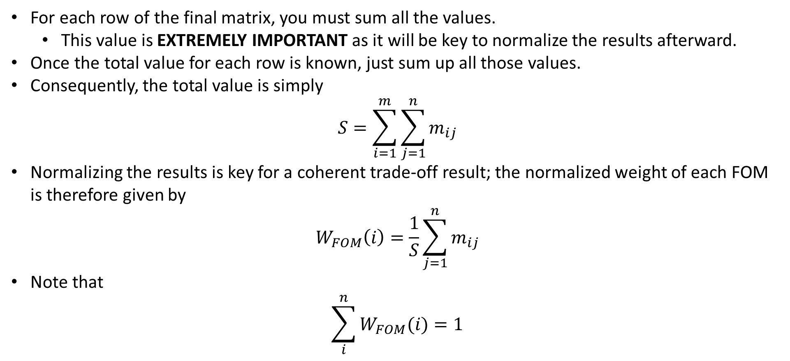
STEP 4: SUMMATION AND WEIGHTS
For each row of the final matrix, you must sum all the values.
This value is EXTREMELY IMPORTANT as it will be key to normalize the results afterward.
Once the total value for each row is known, just sum up all those values.
Consequently, the total value is simply
$$S=\sum_{i=1}^{m}{\sum_{j=1}^{n}{m_{ij}}}$$
Normalizing the results is key for a coherent trade-off result; the normalized weight of each FOM is therefore given by
$$W_{FOM}\left(i\right)=\frac{1}{S}\sum_{j=1}^{n}{m_{ij}}$$
Note that
$$\sum_{i}^{n}{W_{FOM}(i)}=1$$
How to Perform a Trade-Off Analysis

Slide 8
STEP 4: SUMMATION AND WEIGHTS
Here is a result example for lunar dust mitigation techniques
How to Perform a Trade-Off Analysis

Slide 9
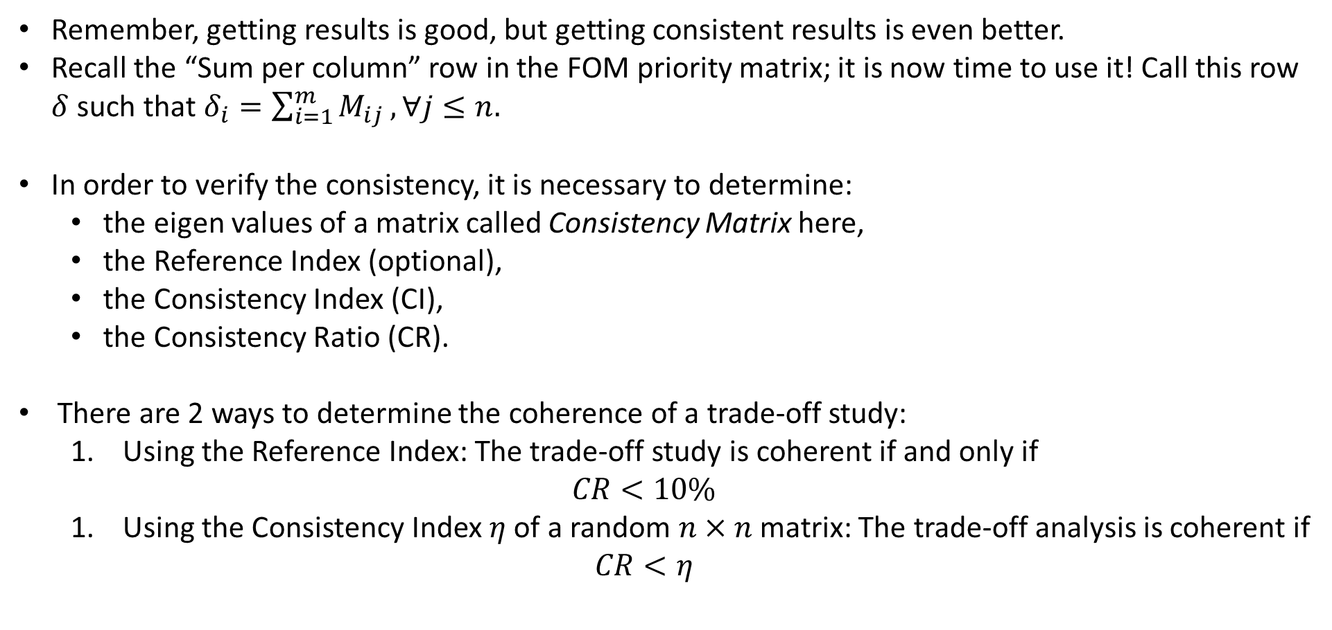
STEP 5: TRADE-OFF CONSISTENCY ANALYSIS
Remember, getting results is good, but getting consistent results is even better.
Recall the “Sum per column” row in the FOM priority matrix; it is now time to use it! Call this row $δ$ such that $δ_{i}=\sum_{i=1}^{m}{M_{ij}}, ∀j≤n.$
In order to verify the consistency, it is necessary to determine:
the eigen values of a matrix called Consistency Matrix here,
the Reference Index (optional),
the Consistency Index (CI),
the Consistency Ratio (CR).
There are 2 ways to determine the coherence of a trade-off study:
Using the Reference Index: The trade-off study is coherent if and only if
$$CR<10\%$$
Using the Consistency Index $η$ of a random $n×n$ matrix: The trade-off analysis is coherent if
$$CR<η$$
How to Perform a Trade-Off Analysis

Slide 10
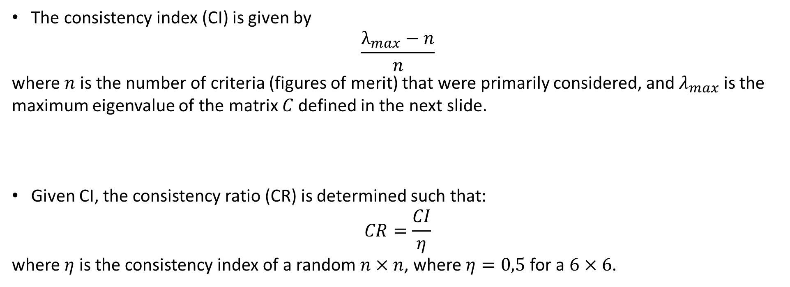
STEP 5: TRADE-OFF CONSISTENCY ANALYSIS
The consistency index (CI) is given by
$$\frac{λ_{max}−n}{n}$$
where $n$ is the number of criteria (figures of merit) that were primarily considered, and $λ_{max}$ is the maximum eigenvalue of the matrix $C$ defined in the next slide.
Given CI, the consistency ratio (CR) is determined such that:
$$CR=\frac{CI}{η}$$
where $η$ is the consistency index of a random $n×n$, where $η=0,5$ for a $6×6$.
How to Perform a Trade-Off Analysis

Slide 11
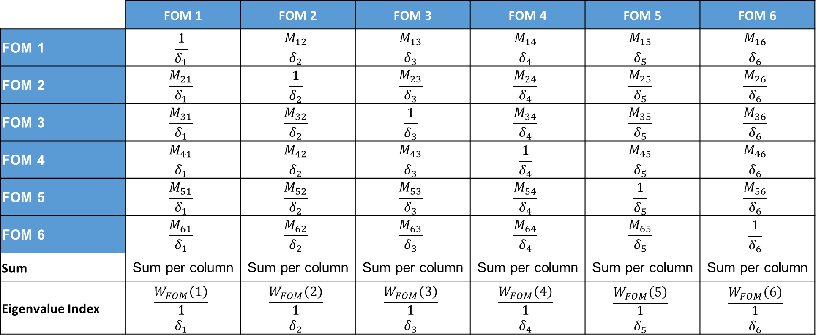
STEP 5: TRADE-OFF CONSISTENCY ANALYSIS
The Consistency Matrix is defined as follows:
 | FOM 1 | FOM 2 | FOM 3 | FOM 4 | FOM 5 | FOM 6
FOM 1 | $$\frac{1}{δ_{1}}$$ | $$\frac{M_{12}}{δ_{2}}$$ | $$\frac{M_{13}}{δ_{3}}$$ | $$\frac{M_{14}}{δ_{4}}$$ | $$\frac{M_{15}}{δ_{5}}$$ | $$\frac{M_{16}}{δ_{6}}$$
FOM 2 | $$\frac{M_{21}}{δ_{1}}$$ | $$\frac{1}{δ_{2}}$$ | $$\frac{M_{23}}{δ_{3}}$$ | $$\frac{M_{24}}{δ_{4}}$$ | $$\frac{M_{25}}{δ_{5}}$$ | $$\frac{M_{26}}{δ_{6}}$$
FOM 3 | $$\frac{M_{31}}{δ_{1}}$$ | $$\frac{M_{32}}{δ_{2}}$$ | $$\frac{1}{δ_{3}}$$ | $$\frac{M_{34}}{δ_{4}}$$ | $$\frac{M_{35}}{δ_{5}}$$ | $$\frac{M_{36}}{δ_{6}}$$
FOM 4 | $$\frac{M_{41}}{δ_{1}}$$ | $$\frac{M_{42}}{δ_{2}}$$ | $$\frac{M_{43}}{δ_{3}}$$ | $$\frac{1}{δ_{4}}$$ | $$\frac{M_{45}}{δ_{5}}$$ | $$\frac{M_{46}}{δ_{6}}$$
FOM 5 | $$\frac{M_{51}}{δ_{1}}$$ | $$\frac{M_{52}}{δ_{2}}$$ | $$\frac{M_{53}}{δ_{3}}$$ | $$\frac{M_{54}}{δ_{4}}$$ | $$\frac{1}{δ_{5}}$$ | $$\frac{M_{56}}{δ_{6}}$$
FOM 6 | $$\frac{M_{61}}{δ_{1}}$$ | $$\frac{M_{62}}{δ_{2}}$$ | $$\frac{M_{63}}{δ_{3}}$$ | $$\frac{M_{64}}{δ_{4}}$$ | $$\frac{M_{65}}{δ_{5}}$$ | $$\frac{1}{δ_{6}}$$
Sum | Sum per column | Sum per column | Sum per column | Sum per column | Sum per column | Sum per column
Eigenvalue Index | $$\frac{W_{FOM}\left(1\right)}{\frac{1}{δ_{1}}}$$ | $$\frac{W_{FOM}\left(2\right)}{\frac{1}{δ_{2}}}$$ | $$\frac{W_{FOM}\left(3\right)}{\frac{1}{δ_{3}}}$$ | $$\frac{W_{FOM}\left(4\right)}{\frac{1}{δ_{4}}}$$ | $$\frac{W_{FOM}\left(5\right)}{\frac{1}{δ_{5}}}$$ | $$\frac{W_{FOM}\left(6\right)}{\frac{1}{δ_{6}}}$$
How to Perform a Trade-Off Analysis

